Slide 1
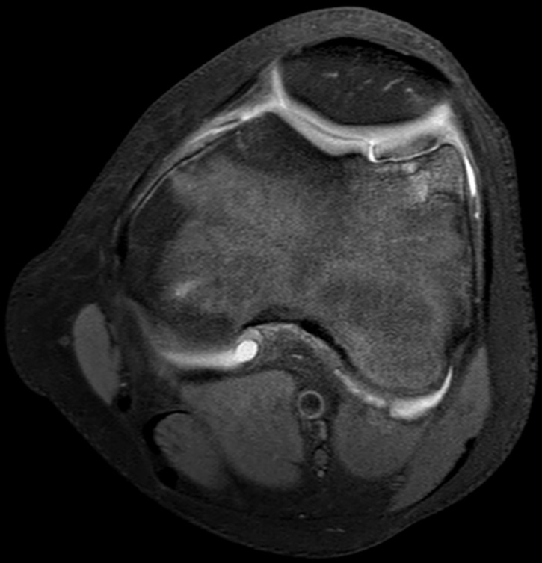
Paediatric Knee MRI

Slide 2
Indications for GP referred Medicare Rebatable MRI knee studies in children under 16 years of age
Following radiographic examination:
for internal joint derangement
Differs from adult rebate criteria:
Cruciate ligament, meniscal or articular surface injury such as acute fractures or osteochondritis dissecans
may be acute or chronic (therefore covers conditions such as osteochondritis dissecans) unlike the adult knee rebate that must be for acute injury

Slide 3
Traumatic & overuse causes of knee pain in children
Acute trauma
Patellar dislocation
Cruciate ligament tears
Meniscal tears
Avulsion injuries (e.g, tibial spine)
Physeal (Salter Harris fractures)
Osteochondral fracture
Nonacute/overuse (repetitive microtrauma)
Osteochondritis dissecans
Apophysitis (e.g., Osgood-Schlatter’s, Sinding-Larsen-Johannson)
Stress fractures

Slide 4
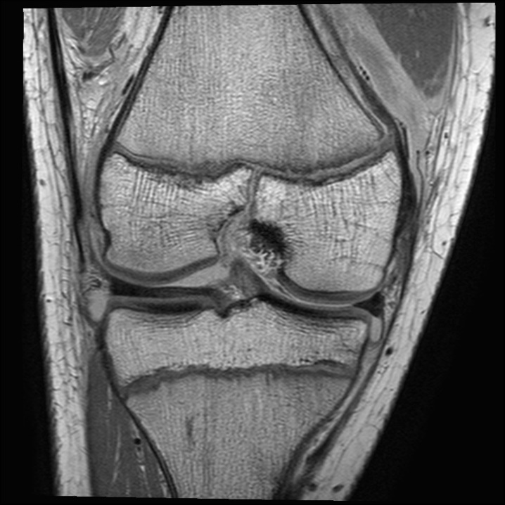
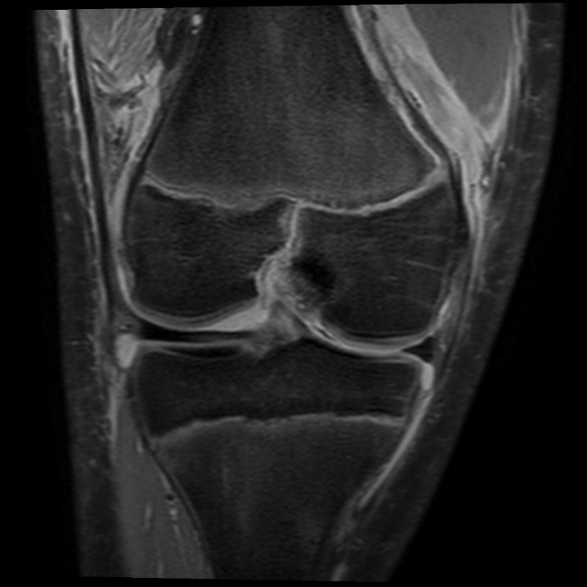
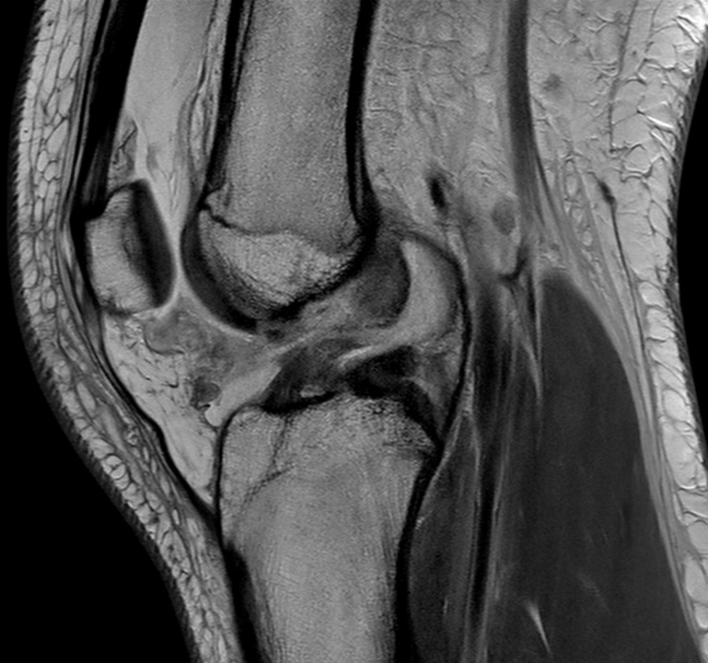
Salter Harris III fracture + ACL tear
Fractured medial distal femoral physis, normal laterally and also normal proximal tibial physis
Epiphyseal component of the fracture extending into notch
Associated ACL tear with discontinuity of the middle of the ACL seen on the sagittal image
Periosteal stripping from medial femoral metaphysis, compared to normal lateral periosteum
PERIOSTEAL STRIPPING

Slide 5
Unstable osteochondritis dissecans. 15yo boy with chronic knee pain.
Bright fluid outlines the unstable osteochondral fragment within the trochlea, representing joint fluid tracking through chondral and osseous fissuring. An unstable fragment is at risk of displacing into the joint as an intraarticular body, leaving a defect.
AXIAL IMAGE THROUGH PATELLOFEMORAL JOINT

Slide 6
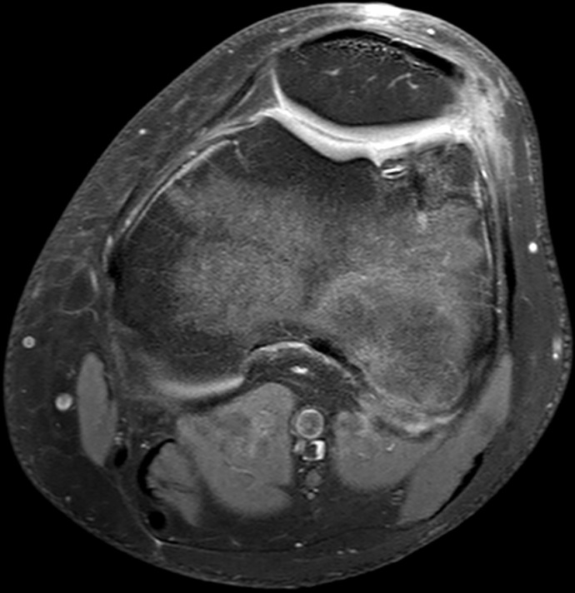
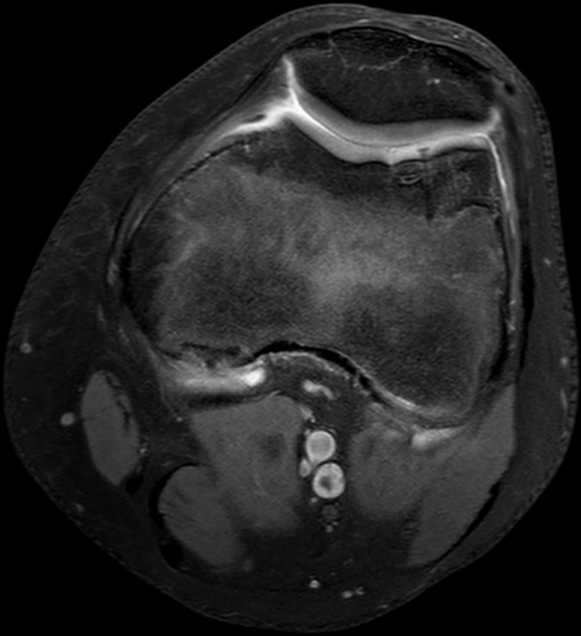
Unstable osteochondritis dissecans. 15yo boy with chronic knee pain.
INITIAL
4 MONTHS
10 MONTHS
Initial scan and follow-up scans after pinning showing healing of the previously unstable fragment.

