Slide 1
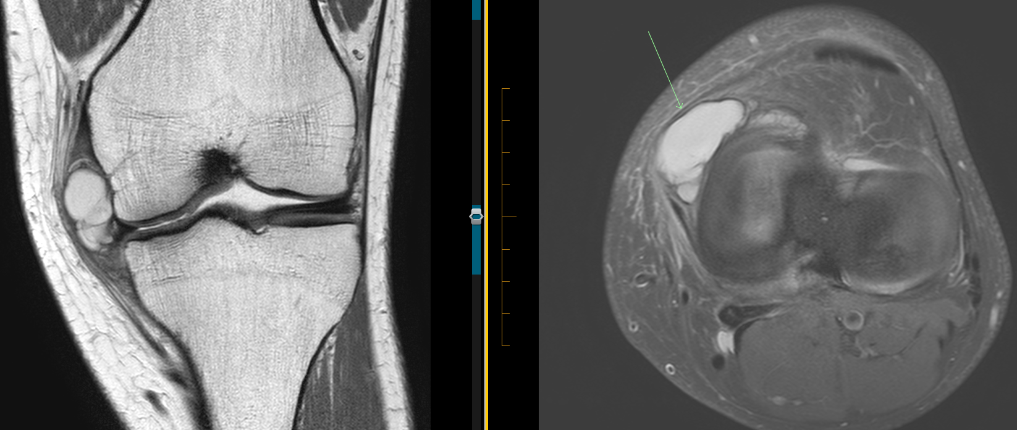
Parameniscal cyst
Large parameniscal cyst peripheral to medial meniscus. Coronal and Axial MRIs

Slide 2
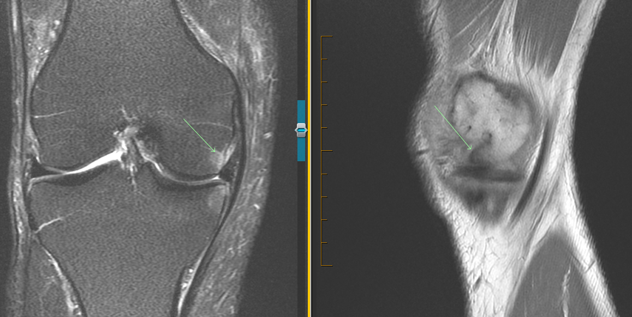
Displaced fragment + stress
Displaced fragment lying in meniscofemoral recess on sagittal MRI (image on right). Coronal MRI shows related subarticular stress response (left image)

Slide 3
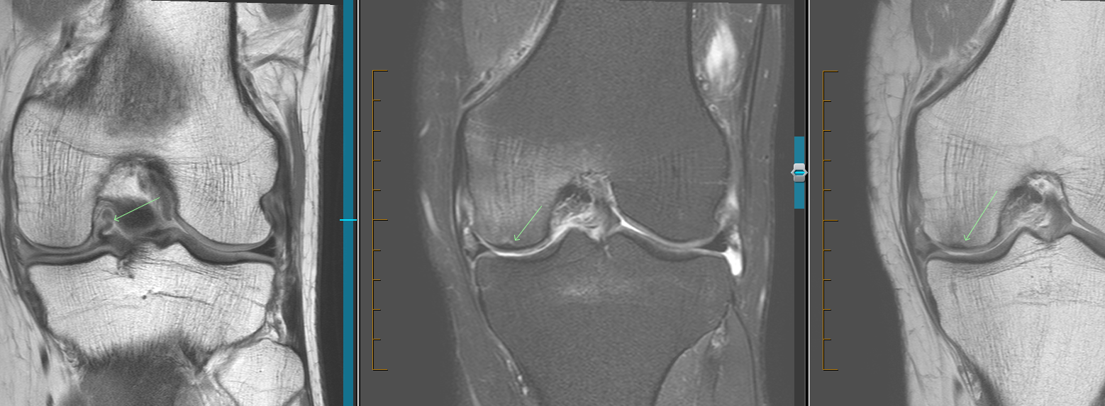
Subchondral insufficiency #
Coronal image on left shows displaced meniscal fragment. Central and left coronal images show subchondral low signal insufficiency fracture of medial femoral condyle. Note surrounding bone marrow oedema of the central image (very painful!)

