Slide 1
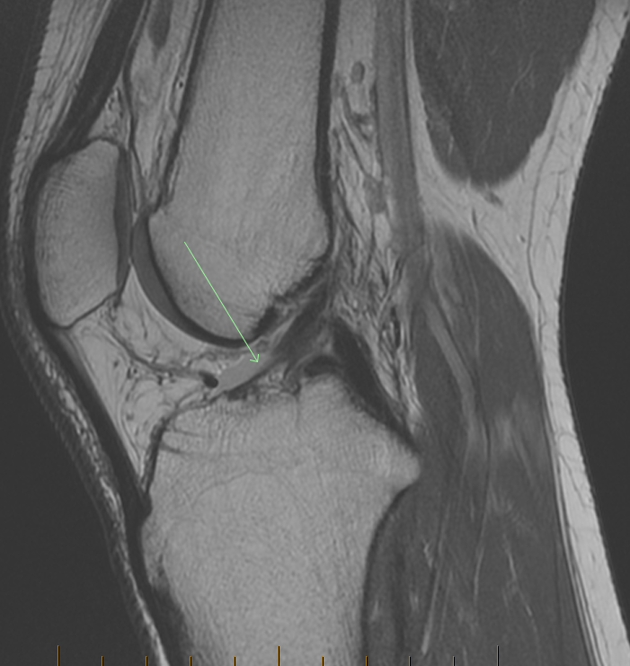
Chronic ACL tears
Usually the torn ACL fibres are significantly attenuated or resorbed
Occasionally the ACL can scar down to the PCL and appear relatively normal on imaging (but should still be insufficient on clinical imaging)
Indirect signs of ACL insufficiency will be sort out by the reporting radiologist and emphasised, if relevant
Chronic ACL tear (arrowed)

